Slide 1

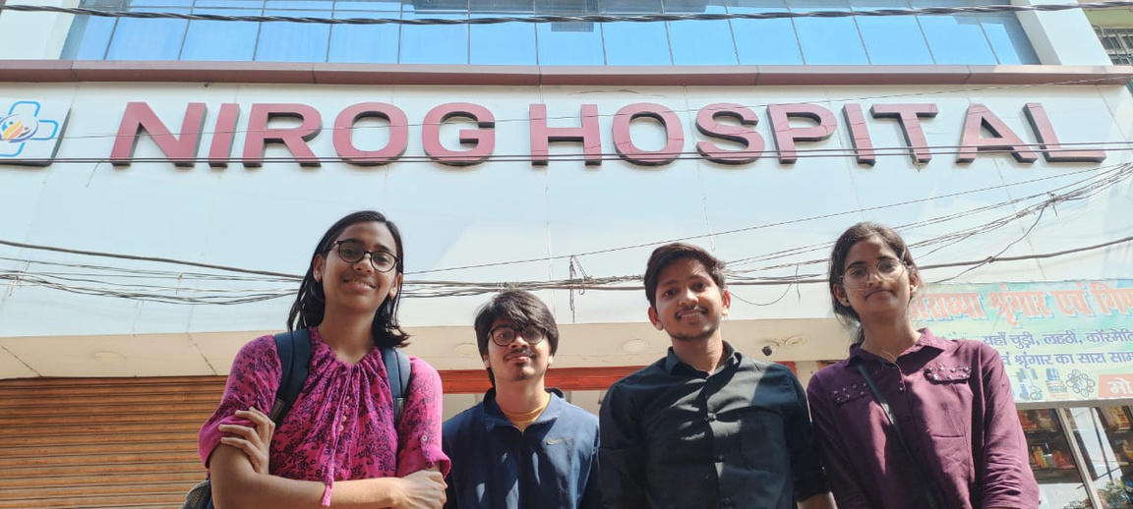


HSS 232 HOSPITAL VISIT REPORT
PRESENTATION BY –
GROUP 11
ANKIT SINGH
DEEPANSHI VERMA
SRIYASH BHASKARUNI
RAVINA BUDANIA

Slide 2

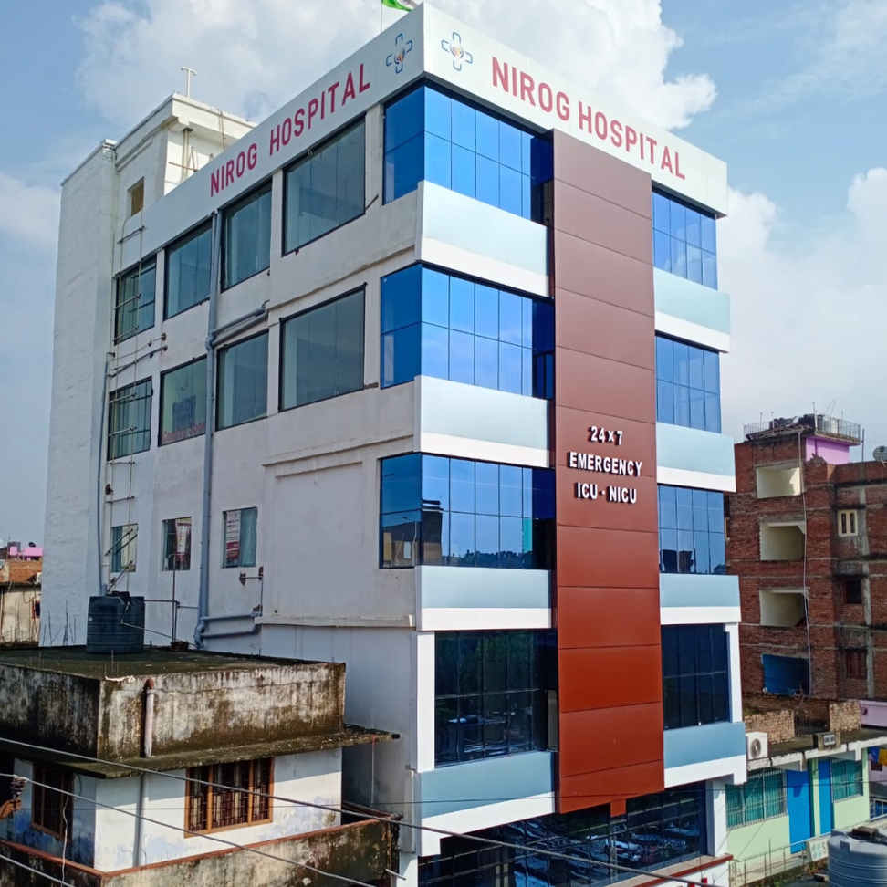




NIROG HOSPITAL
Address- Pillar No.77, Sheikhpura, Bailey Road, Patna
Website: www.niroghospitals.com
Facebook:
https://www.facebook.com/niroghospital
Contact No.:+91-7599975333,
+91-92622 91888

Slide 3
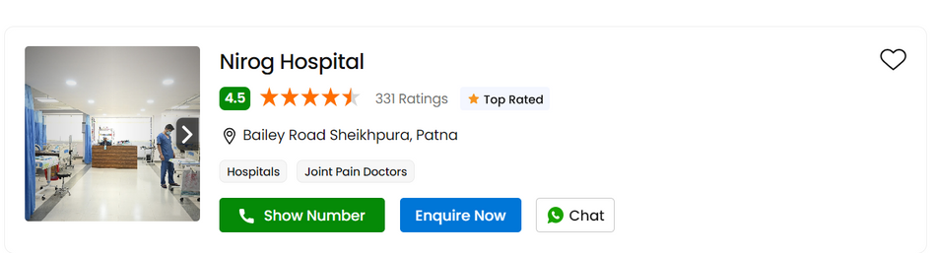
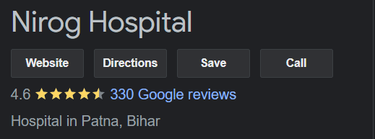
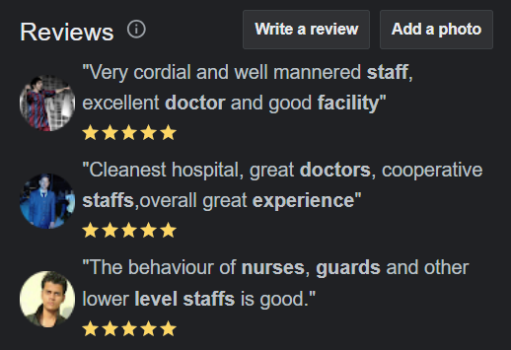
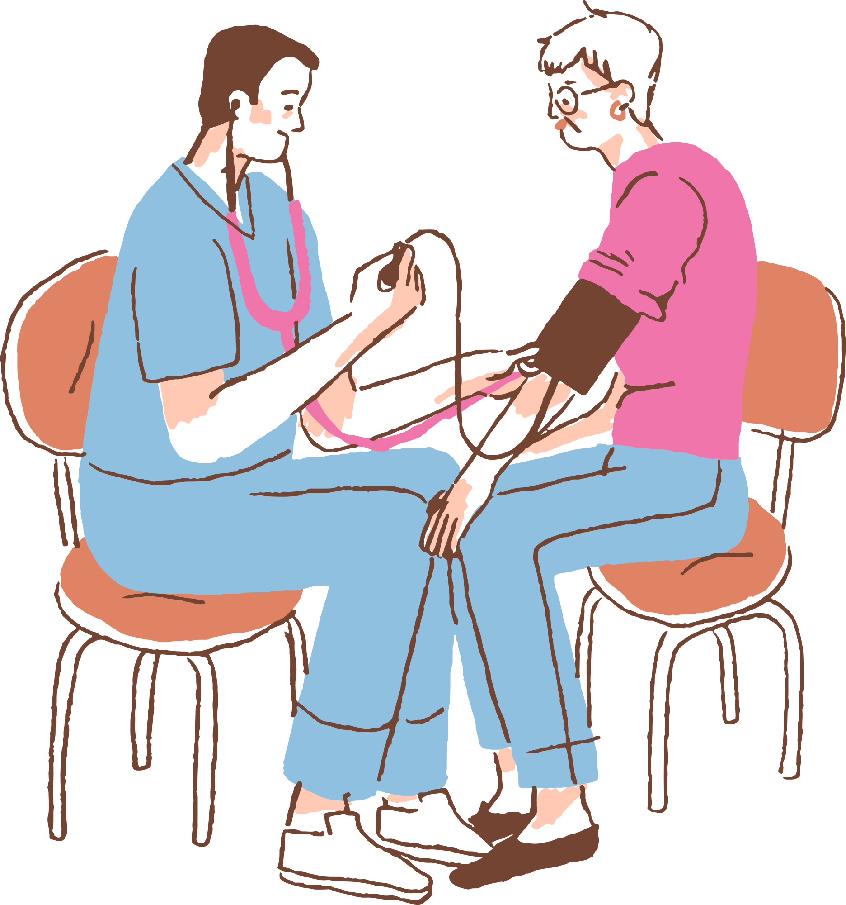
General Facts about the hospital
Private Hospital
24X7 services available
Multispeciality Hospital : Neurology, Internal Medicine, Gynecology, Oncology, Pediatrics, Cardiology, Orthopedics, Psychology, Nutrition and dietetics
Oxygen Cylinders - Available
Blood Bank : Not available ( allied with Paras, Palmview, Prathima, Nirmaya )
Bed Count : 51
Uses IGIMS waste management

Slide 4
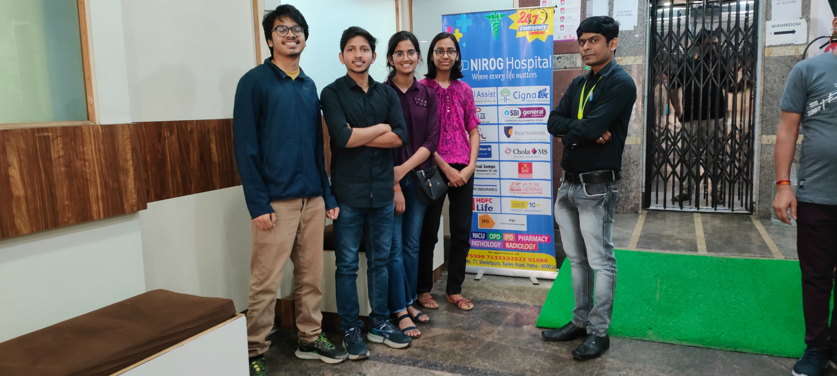

GENERAL INFORMANTION
ICU Bed Count: 12
No. of Operation Theatres: 4
No. of wheelchairs: 4 to 5
General Ward beds: 10
Hospital owns an Ambulance
Medical Shop also available. Cost of medicines ranges from Rs 3 - 25000 ( For Chemotherapy )

Slide 5


SERVICE PROVIDED BY THE HOSPITAL
DEDICATED DEPARTMENTS: IT HAS SPECIALISED UNITS FOR VARIOUS MEDICAL FACALITIES, STAFFED WITH EXPERIENCED HEALTHCARE PROFESSIONALS.
EMERGENCY DEPARTMENT: IT IS WELL-EQUIPPED EMERGENCY FACILITIES FOR IMMEDIATE MEDICAL ATTENTION AND CRITICAL CARE.
ICU AND CRITICAL CARE UNITS: INTENSIVE CARE UNITS FOR PATIENTS REQUIRING CLOSE MONITORING AND SPECIALIZED CARE.
IN HOUSE PHARMACY: ACCESSIBLE TO ALL INDIVIDUALS , ONSITE
PHARMACY FOR EASY MEDICAL ACCESS.
INPATIENT AND OUTPATIENT SERVICES: FACILITIES FOR BOTH ADMITTED PATIENTS REQUIRING HOSPITALIZATION AND THOSE SEEKING OUTPATIENT CONSULTATIONS.

Slide 6
SERVICE PROVIDED BY THE HOSPITAL
REHABILITATION CENTER: PHYSICAL THERAPY AND REHABILITATION SERVICES ARE ALSO PRESENT SUPPORT RECOVERY.
MATERNITY AND PEDIATRIC UNITS: PROVIDES SPECIALISED CARE FOR EXPECTANT MOTHERS.
DIAGNOSTIC SERVICES:
THE HOSPITAL HAVE ITS OWN PATHOLOGY AND RADIOLOGY LAB
TELEMEDICINE SERVICES: UTILIZING TECHNOLOGY FOR REMOTE CONSULTATIONS AND MEDICAL ADVICE
HEALTH CHECKUP PACKAGES: COMPREHENSIVE HEALTH CHECKUPS FOR PREVENTIVE CARE.

Slide 7
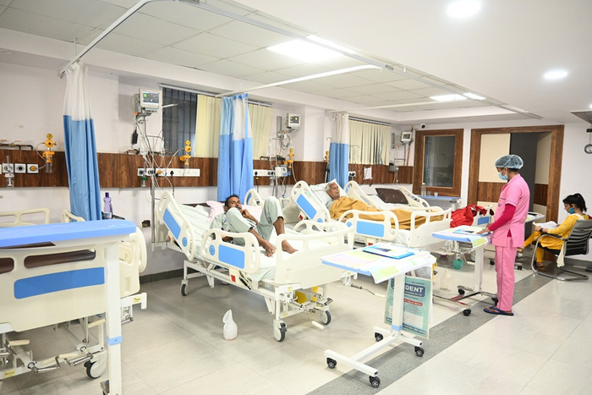
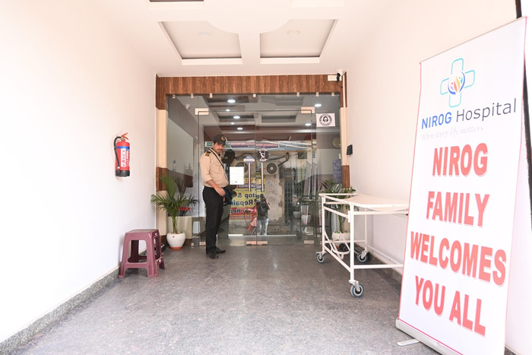
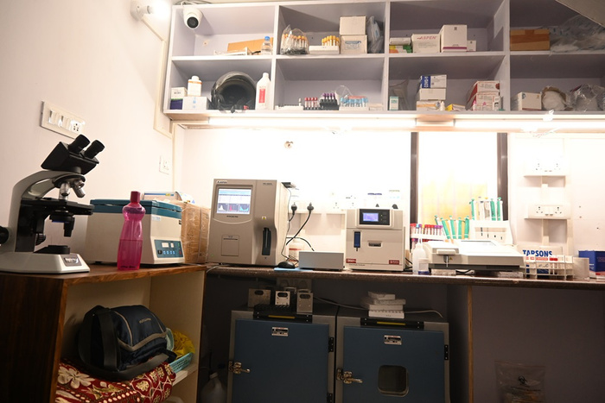
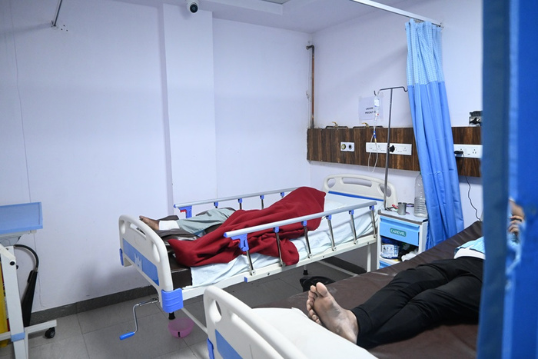
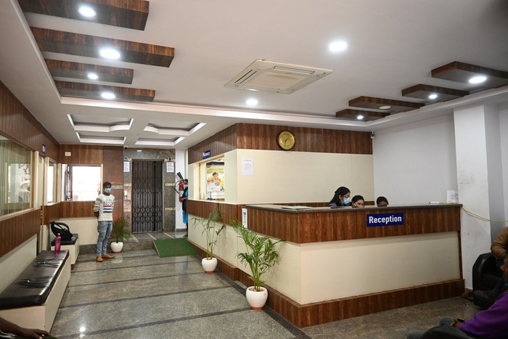
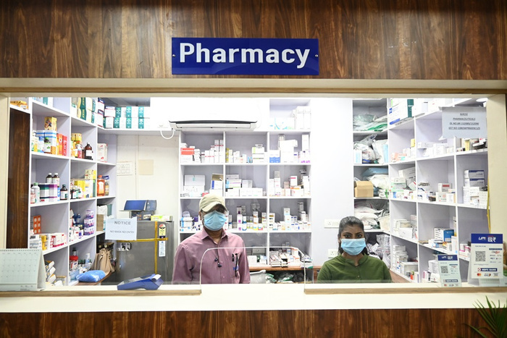
VIRTUAL TOUR OF THE HOSPITAL

Slide 8

QUOTED VS ACTUAL STAFF DATA
No. of Doctors : 120+
Minimum Qualifications of Doctors: M.D mostly, some doctors are M.S also.
No. of Employees : 150+(including guards , nurses, cleaning staff)
Total patients treated till date: 5000+
No. of Doctors : 20
Minimum Qualifications of Doctors: M.D
No. of Nurses : 25
No. of Guards : 6(in each shift)
Cleaning staff : 25
In total : 56 employees

Slide 9
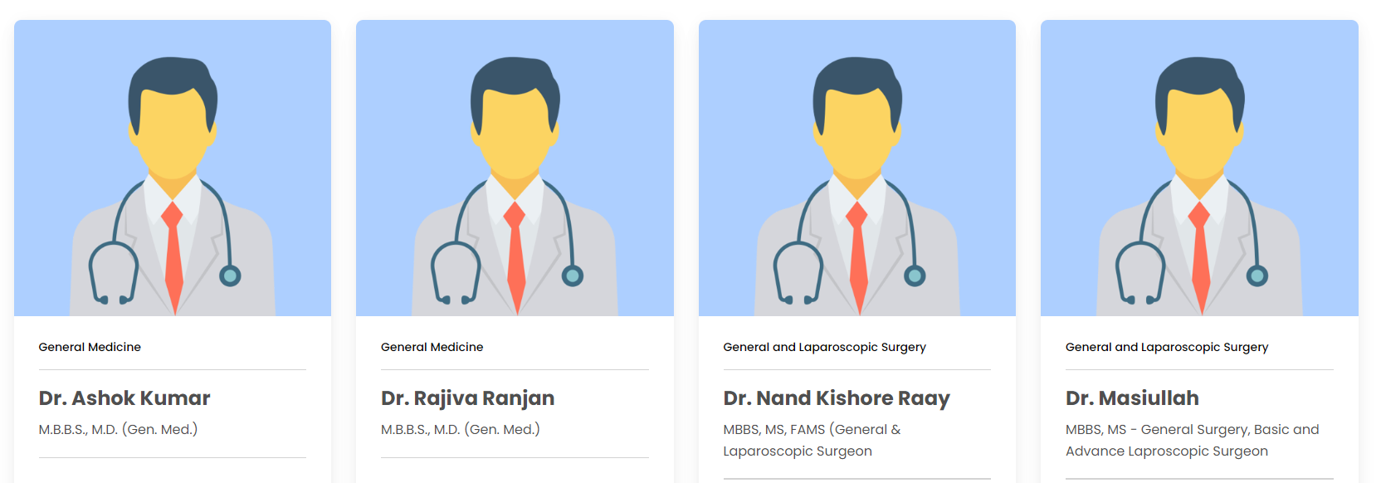
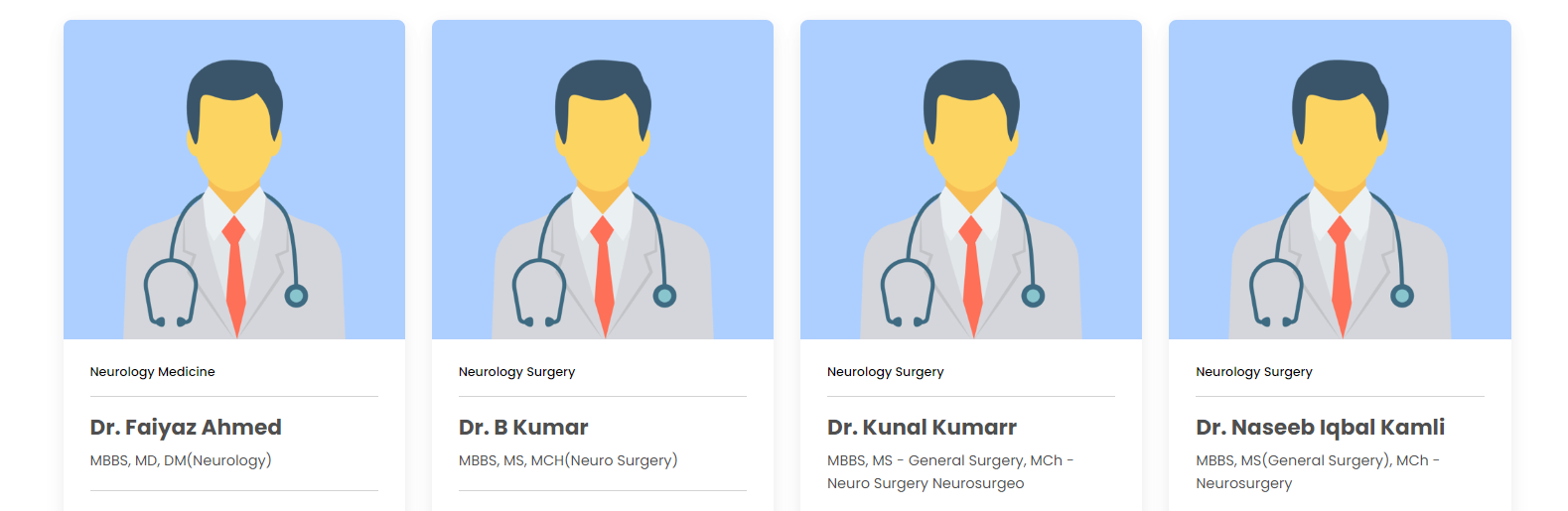

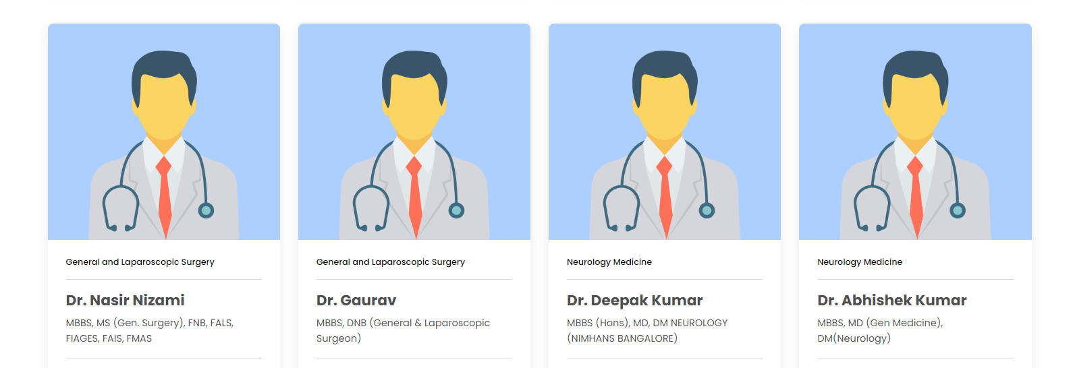
LIST OF THE DOCTORS

Slide 10
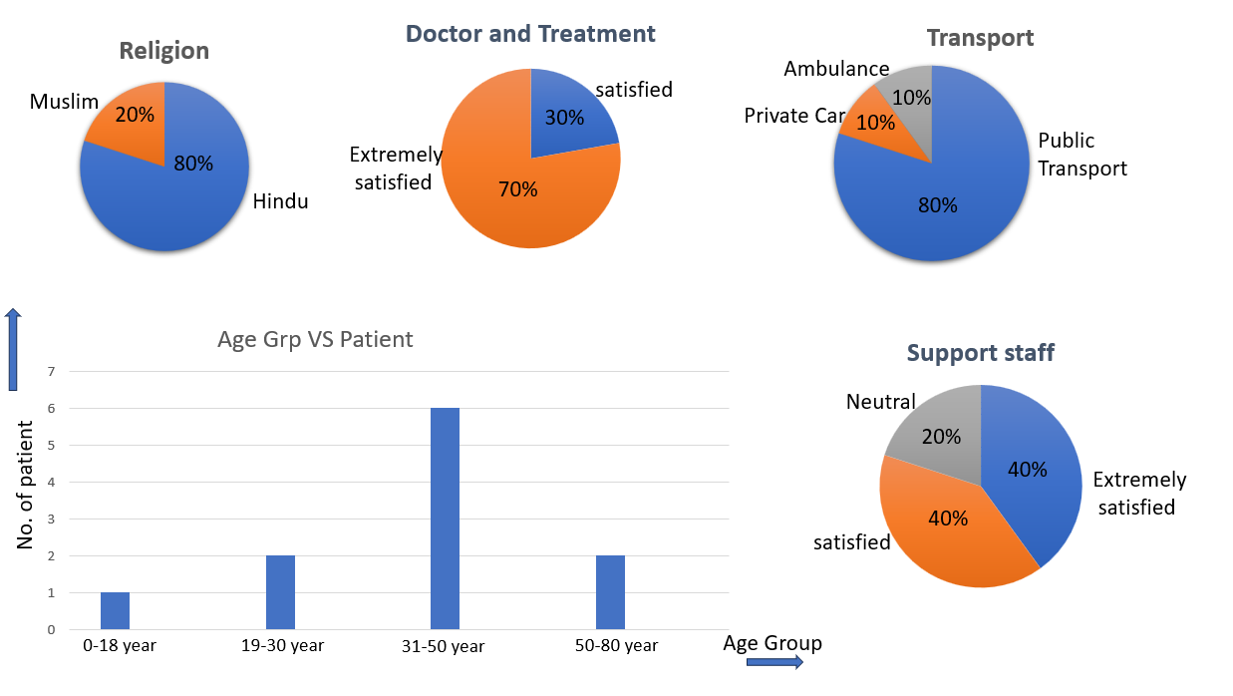
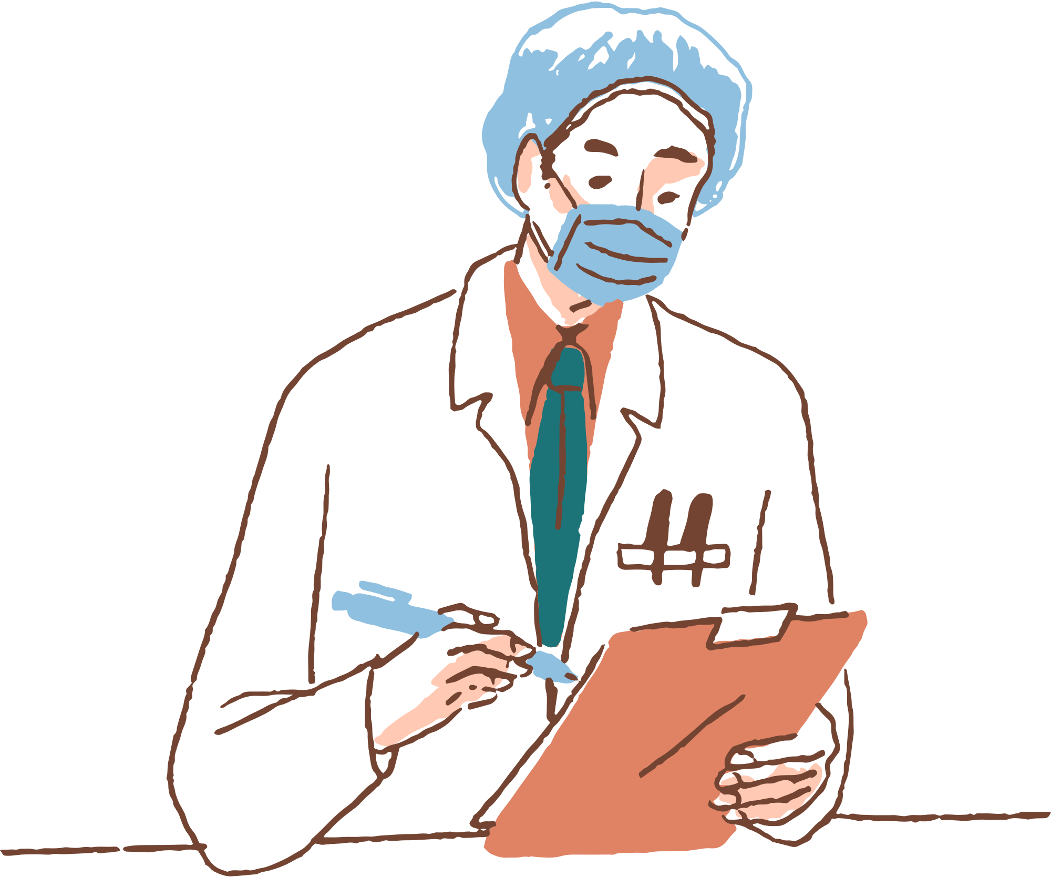
SURVEY ANALYSIS

Slide 11
PROS AND CONS
Clean environment
Inhouse canteen and pharmacy.
Hospital Staff is supportive
CCTV cameras were also present.
No navigation map. We found it difficult to locate the general ward and ICU ward.
No separate washrooms for male, female and transgenders
Under construction : There was no proper waiting area.

Slide 12
PROBLEMS IDENTIFIED
PEOPLE WHO CAME TO NIROG HOSPITAL DIDN'T INITIALLY CHOOSE IT, BUT THEY WERE AWARE OF THE LENGTHY WAITS AND OVERCROWD COMMON IN GOVERNMENT OR LARGE HOSPITALS, JUST TO BEGIN TREATMENT OR EVEN FOR A SIMPLE CHECKUP. SO WE PROPOSE SOLUTIONS TO DECREASE THE WAITING TIME AND REMOVING THE OVERCROWD IN A PARTICULAR HOSPITAL.

Slide 13
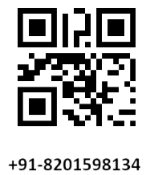
SOLUTION PROPOSED PART 1
WHAT??
The solution to the problem is Sahayak.
SAHAAYAK IS CITY -WIDE QR - WEB BASED PLATFORM.
HOW IT WILL WORK ??
It will show the live number of patients(including those people who have
online booking ) waiting in a particular hospital to visit a particular doctor of
a particular department for e.g.nephrology.
It will also display the number of beds that are unoccupied in the hospital.
QR codes with helpline numbers will be circulated within the city.
HOW WILL THIS QR BE CIRCULATED?
This can be done with the help of brochures, posters and medicine wrappers
and this way they can reach the rural areas too.

Slide 14

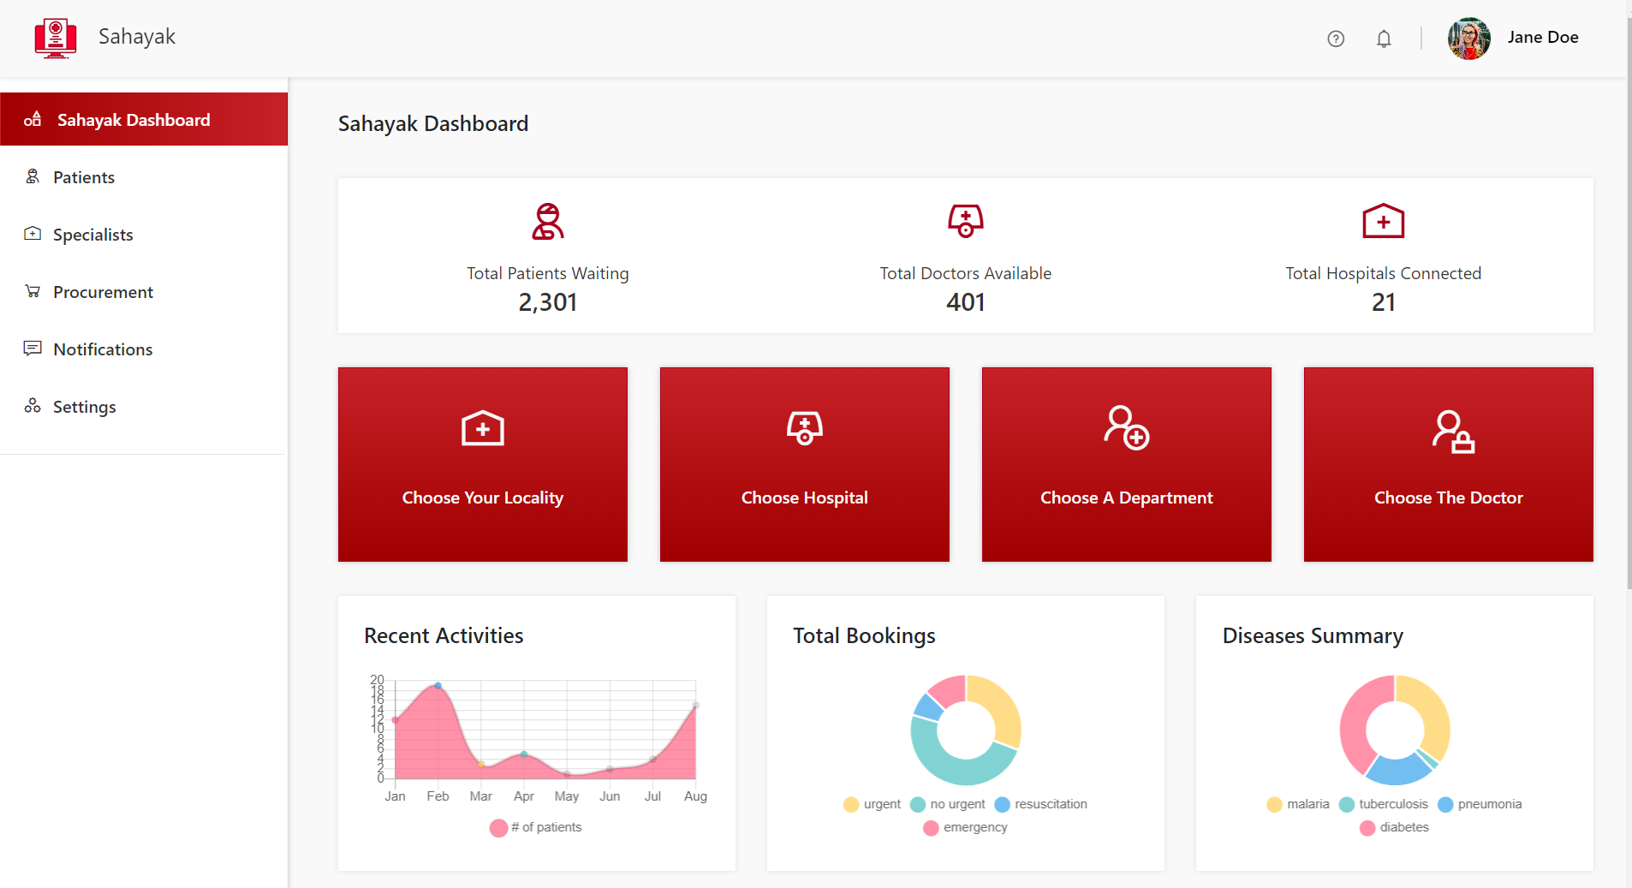
THE SAHAYAK DASHBOARD
Share the QR

Slide 15
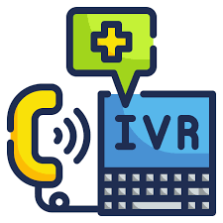
HELPLINE NUMBER
The most important part of society when we address a health care issue are those who are aged or elderly people who can’t use a smart phone or are economically weak and do not own a smart phone. They can use this helpline number which uses IVR (INTERACTIVE VOICE RESPONSE) in four levels. This IVR system will be connected to the Sahayak database and thus will give appropriate results.
LEVEL 1:CHOOSE THE AREA (FOR EX. BAILEY ROAD)
LEVEL2:CHOOSE THE HOSPITAL.
LEVEL3:CHOOSE THE DEPARTMENT
LEVEL4:CHOOSE THE DOCTOR
After passing these four levels you can get the exact number of people who have taken receipts for regular checkups for the same doctor at that particular moment. In this way before leaving the home for a regular checkup you already know where to go for smooth experience of a regular checkup or a visit.
WHO WILL UPDATE SAHAAYAK?
Hospital staff preferably reception counter will update the number of patients and unoccupied beds.

Slide 16
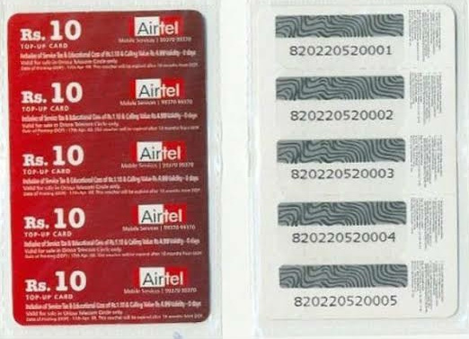
SOLUTION PROPOSED PART 2
WHAT??
The solution to the problem is VIRTUAL
SWASTHYA KHAATA.
HOW??
When we will visit the doctor for the first time he/she will give us a SCRATCH CARD that will be similar to the talktime card we had in previous times to recharge our mobile phone.On scratching the card we will have a code when we will enter the code the VIRTUAL SWASTHYA KHAATA will be updated by a talktime of 5 min .The card will have a validity so that it can be used for follow-ups only.

Slide 17
WHY WILL SOMEONE PREFER THIS WAY?
NO COST OF FOLLOW-UPS
CONVENIENT
ANYBODY WHO HAVE A PHONE WHETHER A KEYPAD OR A SMARTPHONE CAN USE.
WHAT WILL CHANGE ON DOCTOR’S END?
We will modify the prescription of the doctor with a mobile number and a virtual room link. He/she will connect to the patients (FREE OF COST)who just need a follow up on their treatment and do not have a need of physically visiting again using this mobile number or the link.
There will be a fixed hour for each doctor when they will attend these audio chats and video chats with their current patients for the smooth functioning of the system.
If still a patients feels there is a need to visit the doctor again they can physically come and again pay the fees and visit the doctor again. This way we can decrease the number of patients physically meeting the doctor and reduce the overcrowd in the hospitals.
IS THIS FEASIBLE AND CAN BE IMPLEMENTED?
Average consultation time in India is 2 min so a doctor can have follow-up of 30+ patients in that single hour and since people don’t have to come physically and do not even need to register anywhere to have this meet (audio or video).This seems to be feasible and implementable as well.

Slide 18

THANK YOU !!!

